Slide 1
Devops Pipeline
:- Pulkit Dhingra

Slide 2









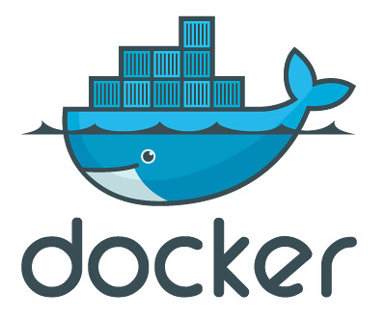

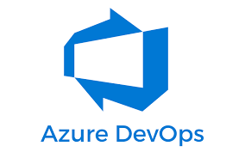

DevOps Pipeline Workflow
Source Code
Commit
Build
Test
Code Quality
Containerize
Artifact storage
Checkout Code
Source Code
Repository
Build code
Deployment
Monitoring

Slide 3





Source Code Repository
Write
Commit
Developer
Code
Source Code Repository

Slide 4

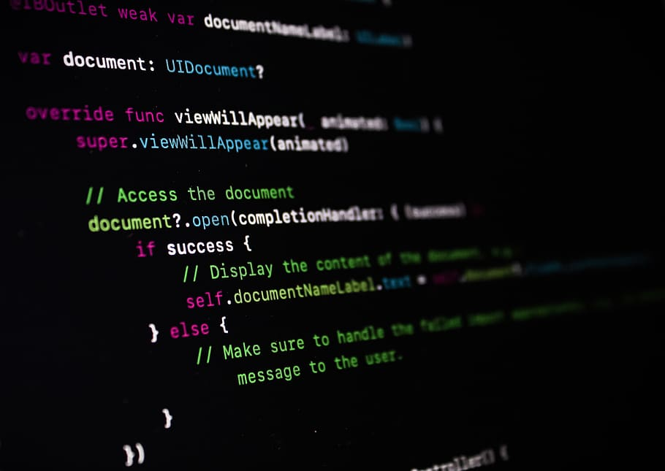


Automatic Builds
Builds are used to get a set of executables that are ready for the deployment purpose.
Commit
Build
Executables

Slide 5
A commit ins the source code repository initiates and automatic build in the pipeline.
Building process includes the unit testing for the code.
The build files are the binaries or executables that are stored locally or in a separate artifact repository.
Code quality testing is also a part of building process.

Slide 6


Artifact storage and Code Quality Analysis
Code Analyser
Analyses the code for possible bugs and checks code quality.
Code redundancy, bugs, performance.
Artifact Registries
Stores the build artifacts generated after the build process.
Versionise system like source code repos.

Slide 7
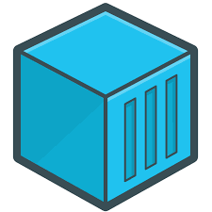

Containerize the application
Containerization is a form of virtualization where the application runs in an isolated environment called containers.
A container consumes less resources than a Virtual machine and is easy to deploy to production.
A container image is stored in a container registry.

Slide 8



Deployment
The stored images are deployed to a deployment server.
The application may run over private servers or cloud..

Slide 9

Monitoring and Logging
Continuous code monitoring is an essential part in devops pipeline. The information collected through monitoring reveals gaps and issues inside the deployment that are needed to be addressed in order to prevent breakdown.
Every step in a pipeline generate some logs. These logs provide a step by step description of what operations were performed and what issues were arrived (id any). Looking at logs helps to get to the corrupt part of the development cycle efficiently.

